Slide 1

Automated UI Testing and Monitoring for your Mobile Apps
José Miguel Torres
Software Engineer
@alegrebandolero
Notes:
Xamarin Introduction!

Slide 2
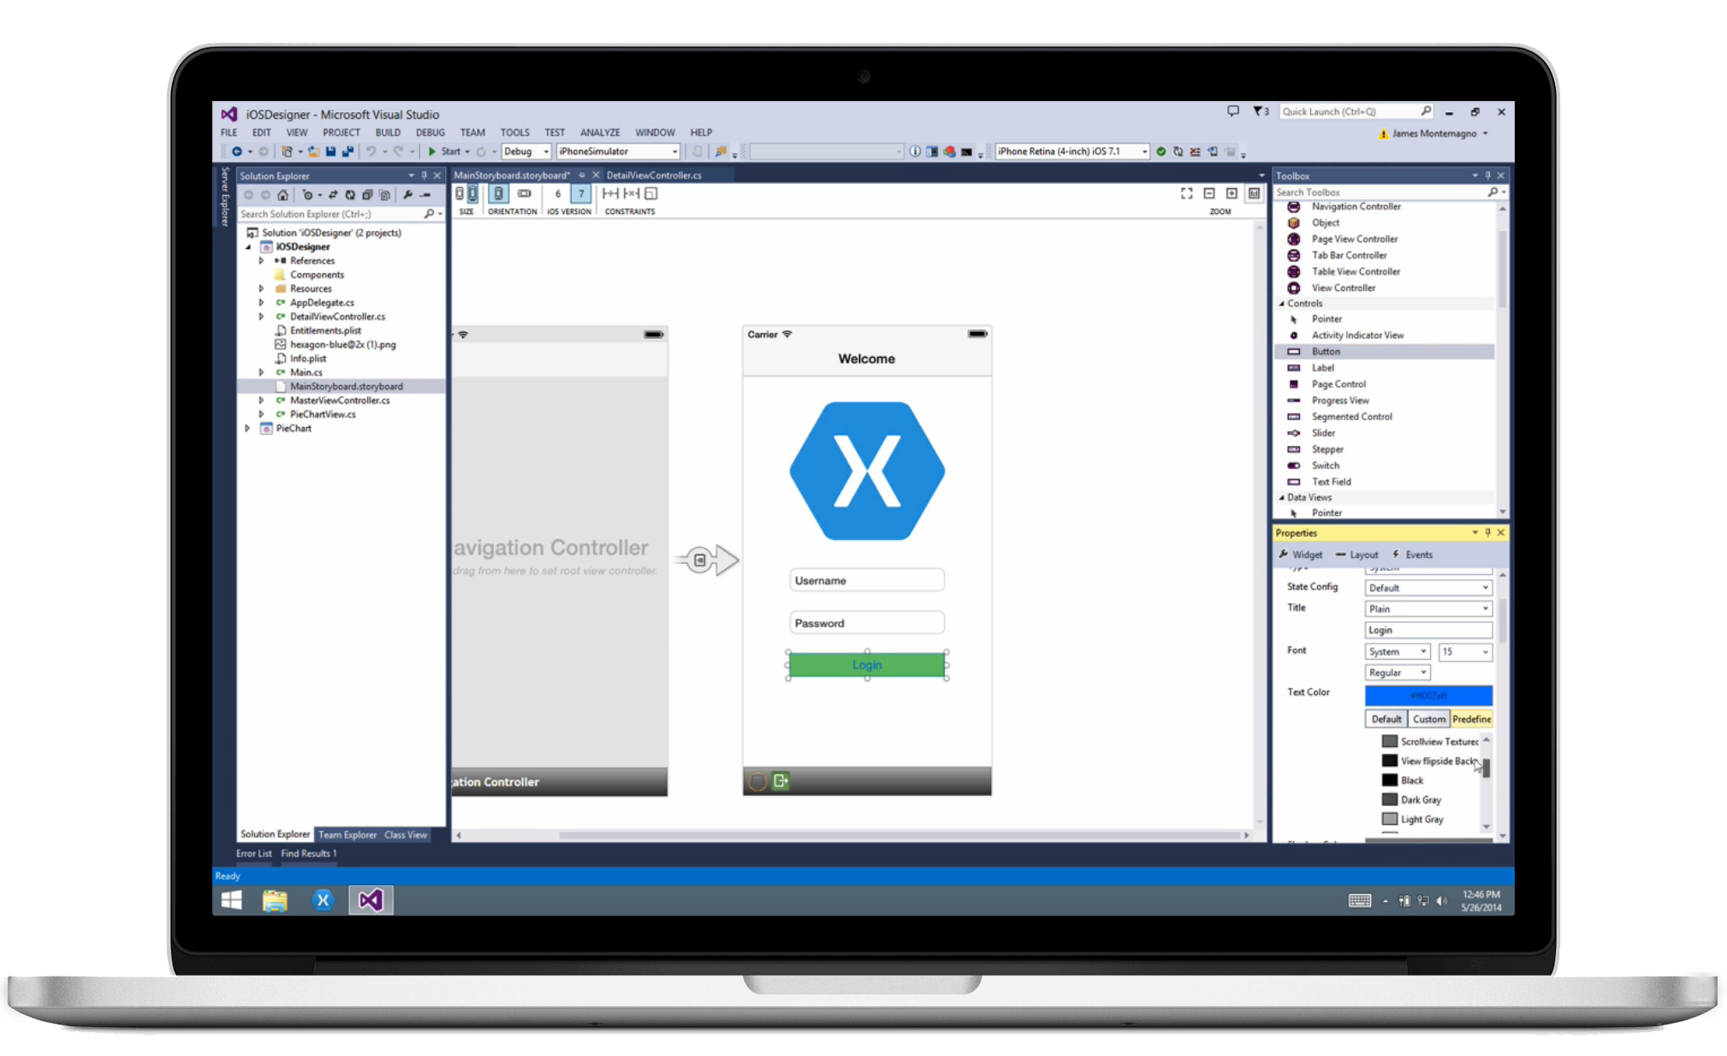
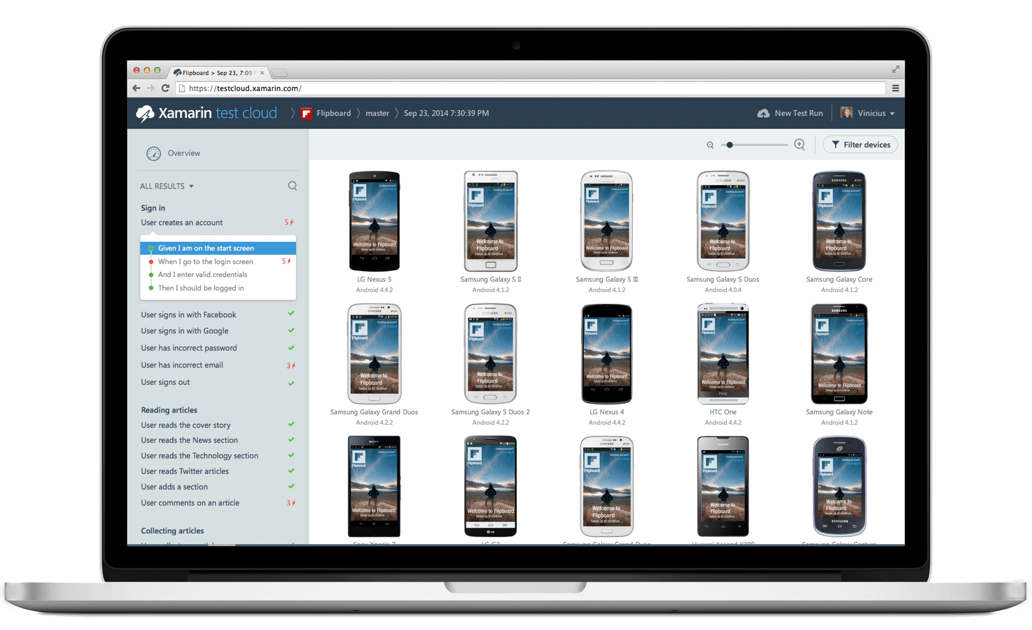
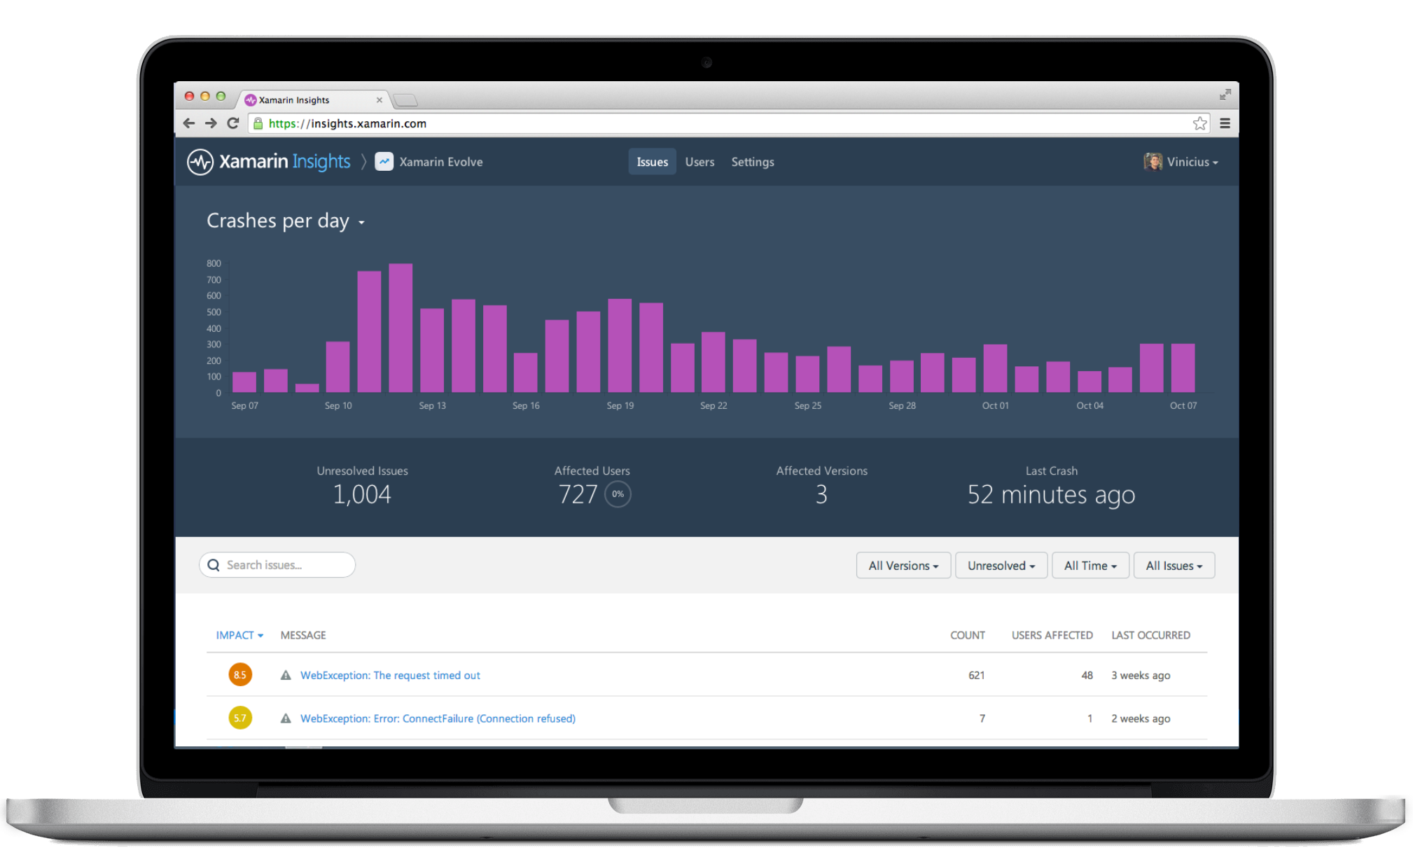



Xamarin – The Complete Mobile Solution
Xamarin Platform
Design
Develop
Integrate
Test
Monitor
Learn
Notes:
Xamarin truly is your entire mobile solution when it comes to app development, testing, and analysis.
The Xamarin Platform is usually what we talk about which is where you can leverage your C# and .NET Skills and Libraries to build native iOS, Android, and Mac apps and share your business logic code with Windows from inside of Visual Studio or Xamarin Studio.
Xamarin Test Cloud, which we will talk about tonight enables you to find bugs before your users do by allowing you to create automated user interface scripts to run locally or see them run on hundreds upon hundreds of physical iOS and Android devices.
Finally, there is Xamarin Insights for real time app monitoring to see you your app is doing and get detailed crash reports with just a single line of code.
To learn all of this Xamarin offers Xamarin University a live and interactive year round training program where you can become a fully certified Xamarin mobile developer.

Slide 3
Mobile
Quality
Challenges
Notes:
We are here to talk about improving app quality using automated UI testing and monitoring for apps, but why is this so important?

Slide 4

Challenges
Device Fragmentation
App Complexity
Fast Release Cycles
Short Sessions
High Mobile User Expectations
Notes:
Well there are several challenges that we must overcome as mobile developers including….

Slide 5


On Mobile, Quality is Hard
5 OS versions
20 devices
20 languages
35 locales
6 screen sizes
9 OS versions
6 Screen configurations
27 screen sizes
39 languages
57 locales
15 Manufacturers
Over 19,000 distinct devices
8
Notes:
First let’s take a look at the shear number of configurations there are between iOS and Android. As iOS progresses this number is only set to increase, and on Android it is already a HUGE number of configurations to even think about testing.
iOS: 7, 7.1, 8, 8.1, 8.2

Slide 6
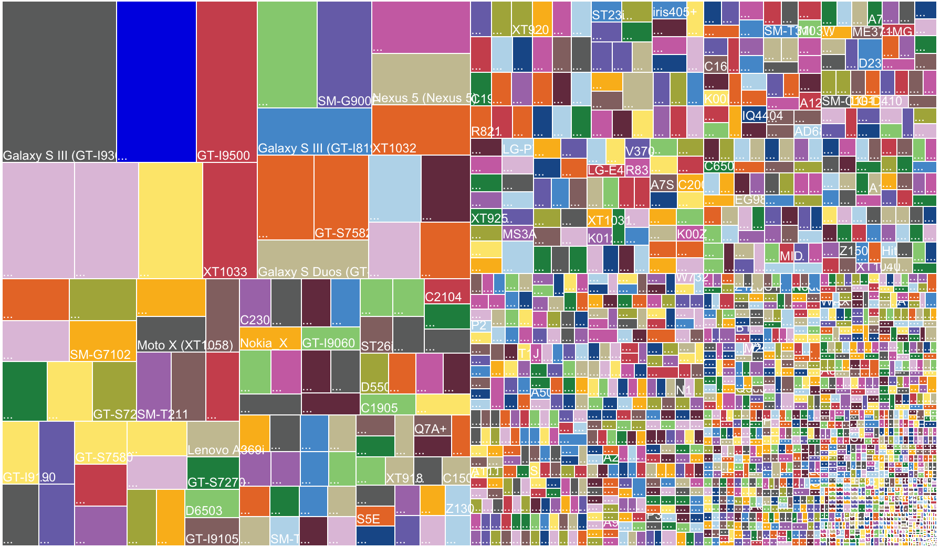


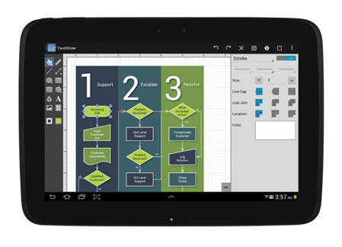
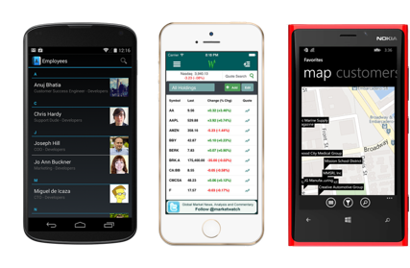
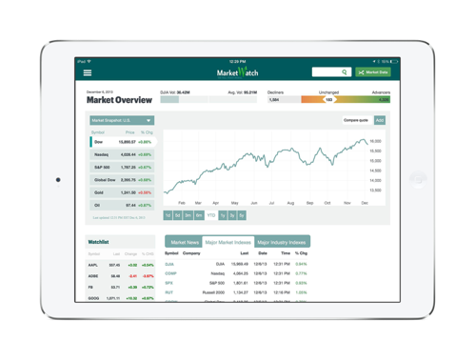
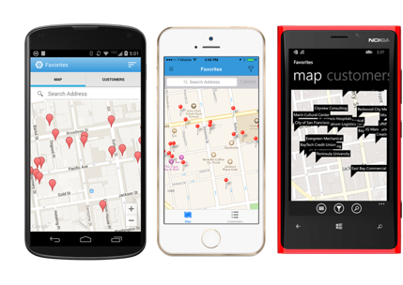
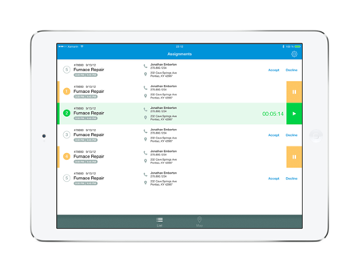
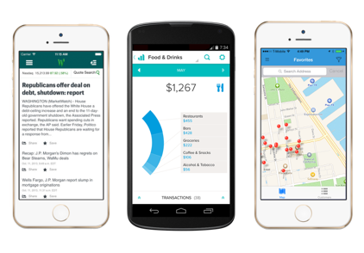
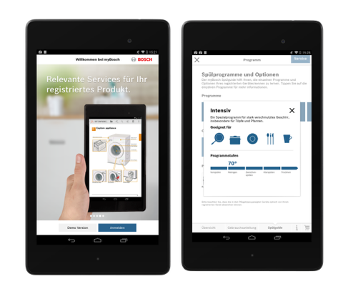
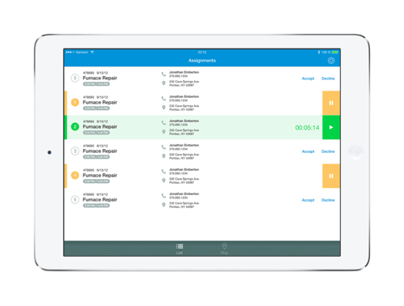
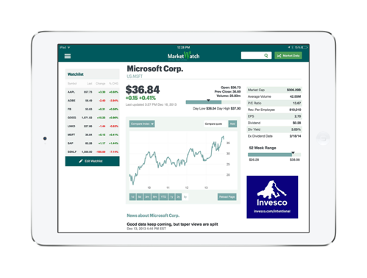
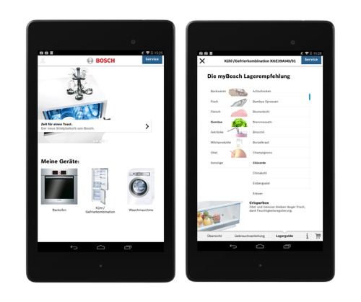
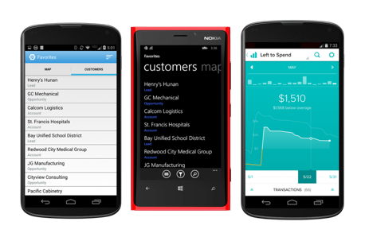
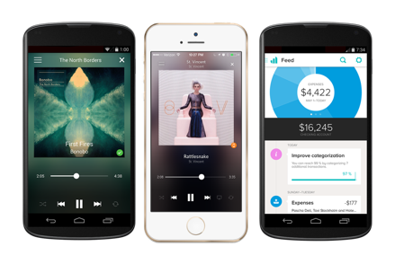
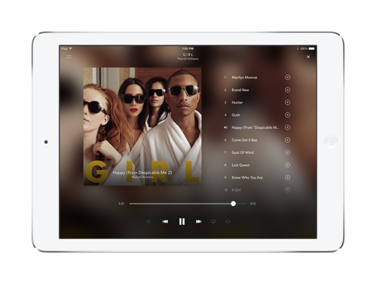
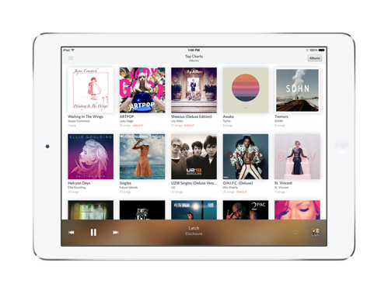
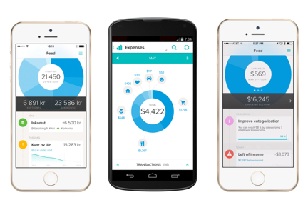
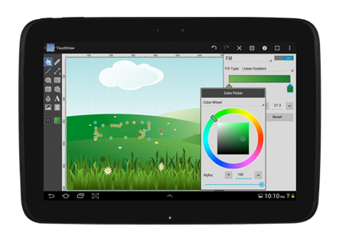
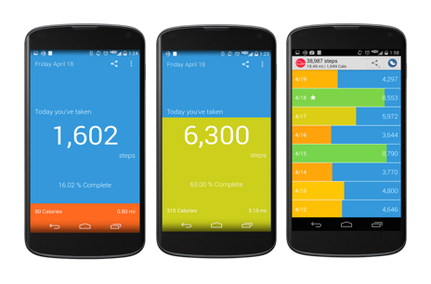
Notes:
OpenSignal is a global app that publishes an annual report on Android device fragmentation based on the distinct Android device types that download their app. This is their August 2014 data, with an astonishing 19,000 device types using their app, up by 60% from just last year.
Different device operating systems, form factors, screen sizes, resolutions, chip sets, and manufacturer modifications make it difficult to know that your app will work well on all devices

Slide 7

Notes:
Looking at just a few of the screen sizes of Samsung devices you couldn’t even fit all of them on the screen, so how do you handle this problem?

Slide 8

U.S. Device Market Coverage Data
288
Companies must test on 134 devices to get to 75% U.S. market coverage
Number of Devices
134
45
13
0
Market Share
25%
50%
75%
90%
Notes:
To hit 75% of the US market you would need over 130 devices and nearly 300 devices to hit 90% of what your users are using today. That is unrealistic to even think about purchasing.

Slide 9
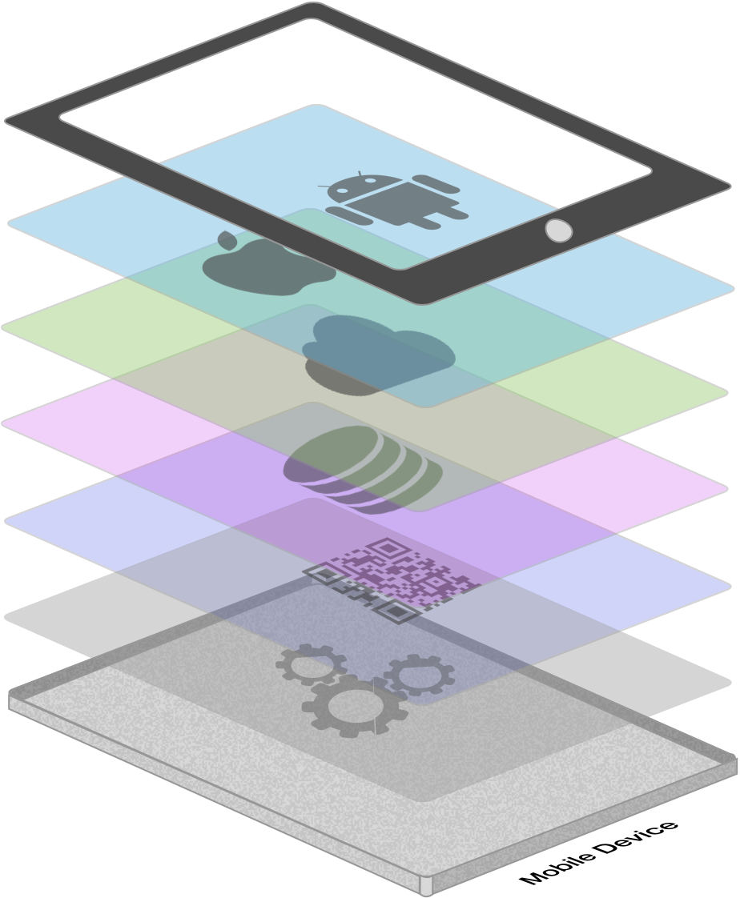





App Complexity
Thousands of iOS and Android APIs
Public web APIs
Backend integrations
Third party libraries
Memory, CPU and network constraints
Notes:
The fragmentation isn’t just in the devices, but as we start to build on our applications you soon found out they are ever increasingly complex.

Slide 10



Short Sessions
Fast Release Cycles
High Mobile User Expectations
Notes:
The final piece of the challenge is actually how people are using apps.
Users expect instant results and fixes for their mobile applications. They crave new features, bug fixes, and they can get them immediate on their devices.
Also, we use apps completely different then desktop. They are only open for minutes, not hours or days, and your app has to perform under these circumstances.
If you fail at any of these your users have the ability to give you instant feedback with a star rating and comment. So perfecting all of these is ever important.

Slide 11
State
Of
Testing
Notes:
So there are a lot of challenges out there for us to tackle, how are we doing, and how do we get where we want to be.

Slide 12
Average Test Suite Today
10
<20%
<25%
code
coverage
continuous
integration
devices
Notes:
Surveying businesses out there we often find that the “normal” test suite is actually only 10 devices across all mobile operating systems. In addition most code coverage for business logic comes in under 20% and only a quarter of companies are using CI in their development cycle. So how can we improve quality and increase these numbers?

Slide 13
How we are testing
High Test Realism
Automated UI testing is the only way to ensure your app
looks
behaves and
performs
well on a broad set of devices—
with every release
Beta Testing
Automated UI Testing
Manual Testing
Rapid Iterations
Long Cycles
Unit Testing
Simplistic Tests
Notes:
There are several different ways to test mobile applications.
We can have extensive beta tests with our users, which is good for hands on, but hard to get feedback.
We can spend hours upon hours manually testing which can help find bugs, but can bog down developers.
Unit testing is essential for our business logic, but only Automated UI Testing can really ensure that as we add new features and fix bugs our UI isn’t impacted before we release.

Slide 14
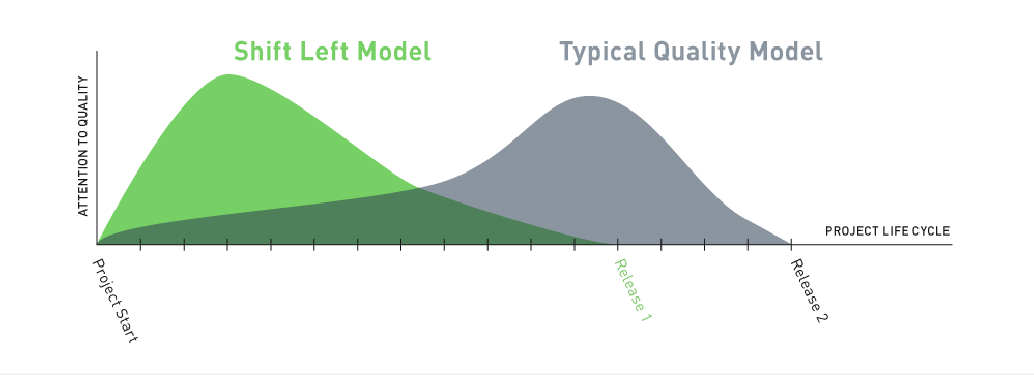
A Different Approach
Notes:
An approach that has proved successful is the “Shift Left” model, which says let’s start business logic and UI testing at the very start of development. From the very first screen that we create so as we continue to release our quality is extremely high and we only need to write new tests, not play catch up.

Slide 15
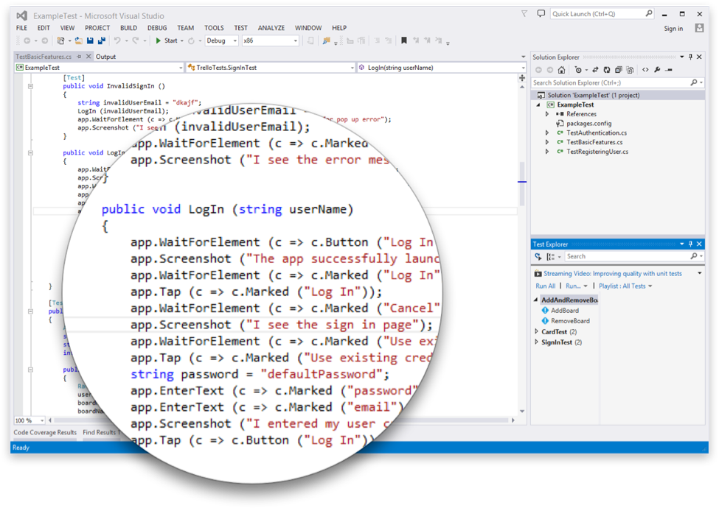
Introducing Xamarin.UITest
Create Automated User Interface tests all in C#
Upload to the Test Cloud or run against a Device or Simulator
Run directly from Visual Studio or Xamarin Studio
Exposed via a NuGet Package
FREE to use a Simulator*
Works on ANY app: Native, Hybrid, or Xamarin
Notes:
This is where Xamarin.UITest comes in to help with this shift. Xamarin.UITest is a framework that ties in directly to the Nunit testing framework to write the UI tests. You can even run them directly against a simulator for free to do regression tests on your applications.

Slide 16

Notes:
With a simple command you can simulate all of your users interactions to build out a great test suite that can be run over and over again.

Slide 17

Notes:
You can even adjust currency, language, and network conditions.

Slide 18
Demo
Notes:
Let’s take a look

Slide 19
Go Farther
Notes:
With our tests created we can do more with them with the power of Xamarin’s Test Cloud

Slide 20

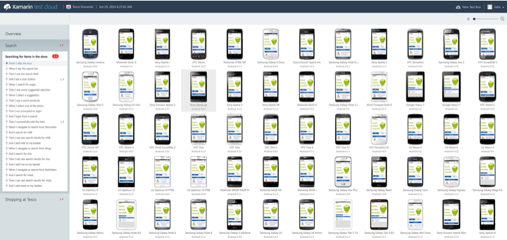
Notes:
We can take our tests and ship them to the Test Cloud to see them run on hundred of physical iOS and Android devices..

Slide 21
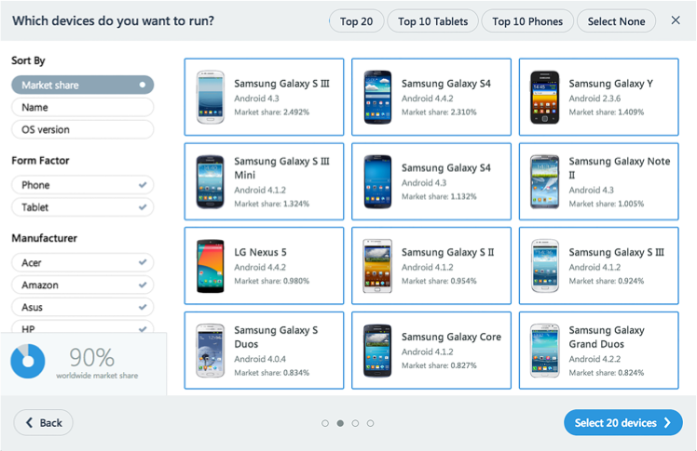
Notes:
You can even see the market share and pick what devices you care about.

Slide 22
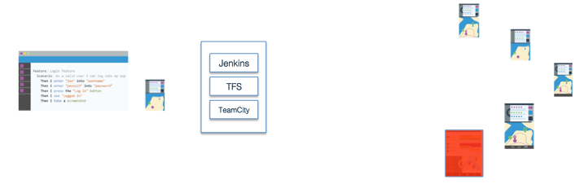
Notes:
Then you can integrate it into your CI system to ensure that before you ship your app nothing has regressed.

Slide 23
Demo
Notes:
Let’s see what this looks like in action.

Slide 24

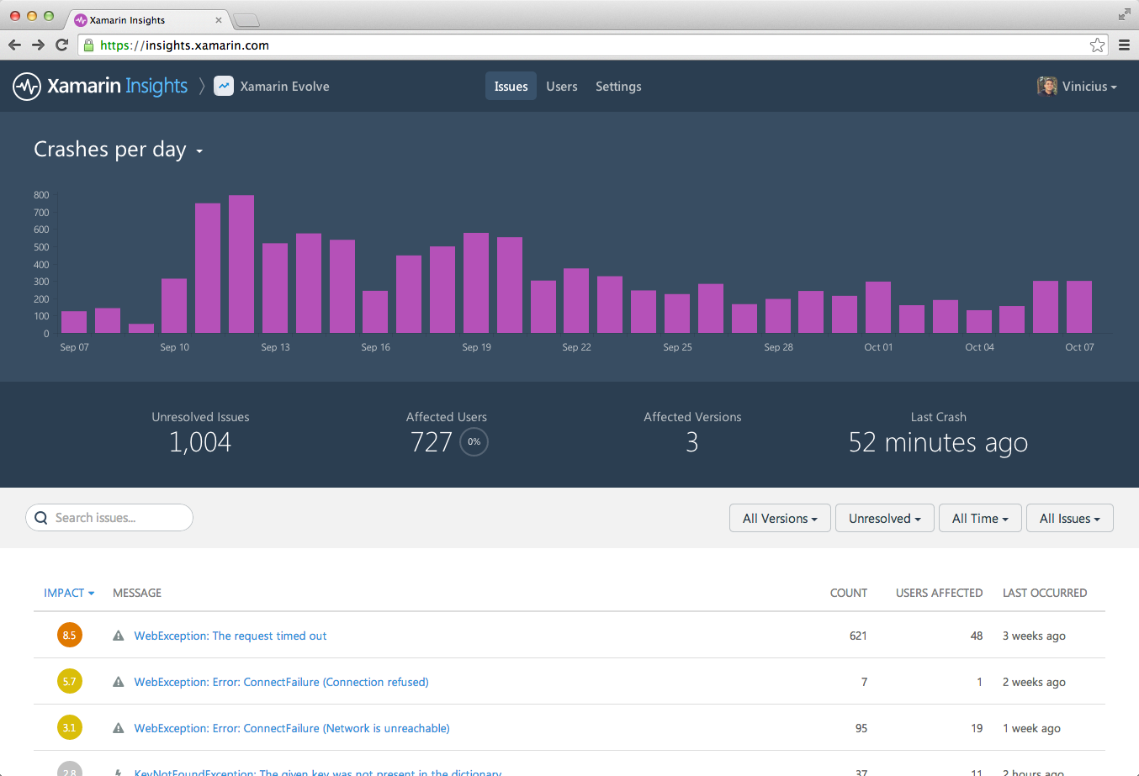
Real-time monitoring. Track crashes and exceptions to understand what is happening with live users.
Notes:
How about after we ship our app to the app stores? How do we monitor performance, crashes, and analytics? Well Xamarin has a solution for all of our apps with Xamarin Insights.

Slide 25
Why Analytics
& Crashalytics
Matter
Notes:
Let’s see what this looks like in action.

Slide 26
We are using our phones a lot!
40x
88%
75%
check phone
a day
watching tv
in bathroom
Notes:
It is simple people user their phones and apps A LOT!

Slide 27
People spend a lot of time in apps
189M
200
127
downloads
a day
mins on
phone
mins in apps
Notes:
There are a ton of apps downloaded a day. On average people spend over 2 hours inside applications, so how do we gain insights into how our app is performing, what sections are important, and find out if our app is crashing?

Slide 28
Xamarin.Insights – Realtime monitoring
Supports
Xamarin.iOS
Xamarin.Android
Xamarin.Mac
Windows Phone
Windows Store
Windows Desktop
Currently in preview
Notes:
Xamarin.Insights, currently in preview, enables us to support all of our apps from a full cross platform API.

Slide 29
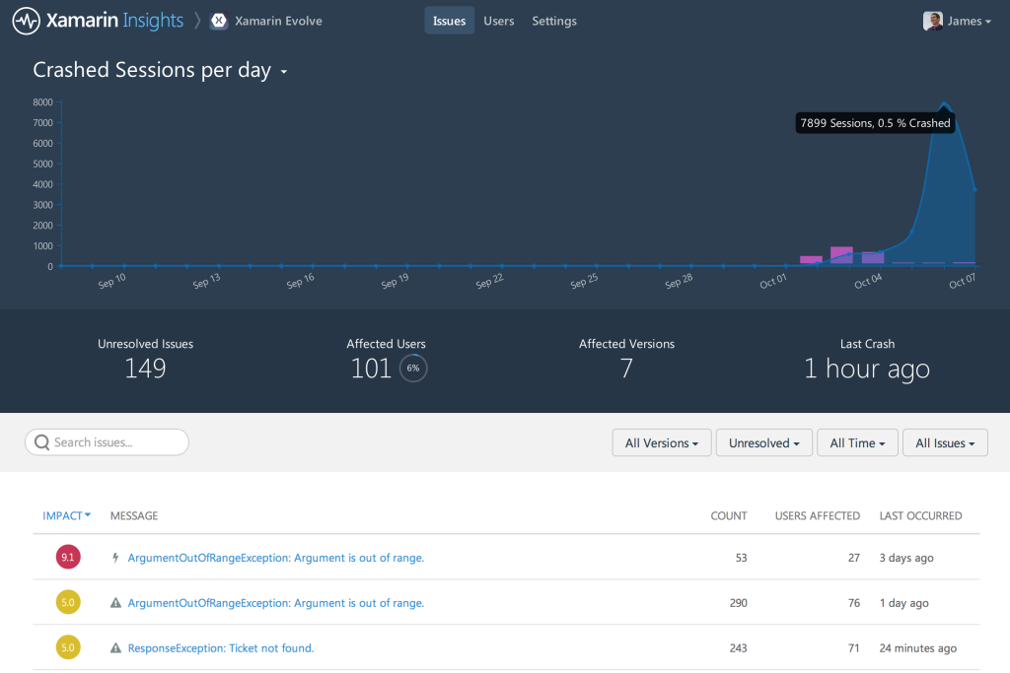
Report
Automatically report any uncaught managed or native exception.
Report your own caught exceptions with simple cross-platform API
Notes:
Automatic MANAGED and NATIVE exceptions are caught with just a single line of code.
You of course can report additional caught exceptions so you can see where things are going wrong.

Slide 30
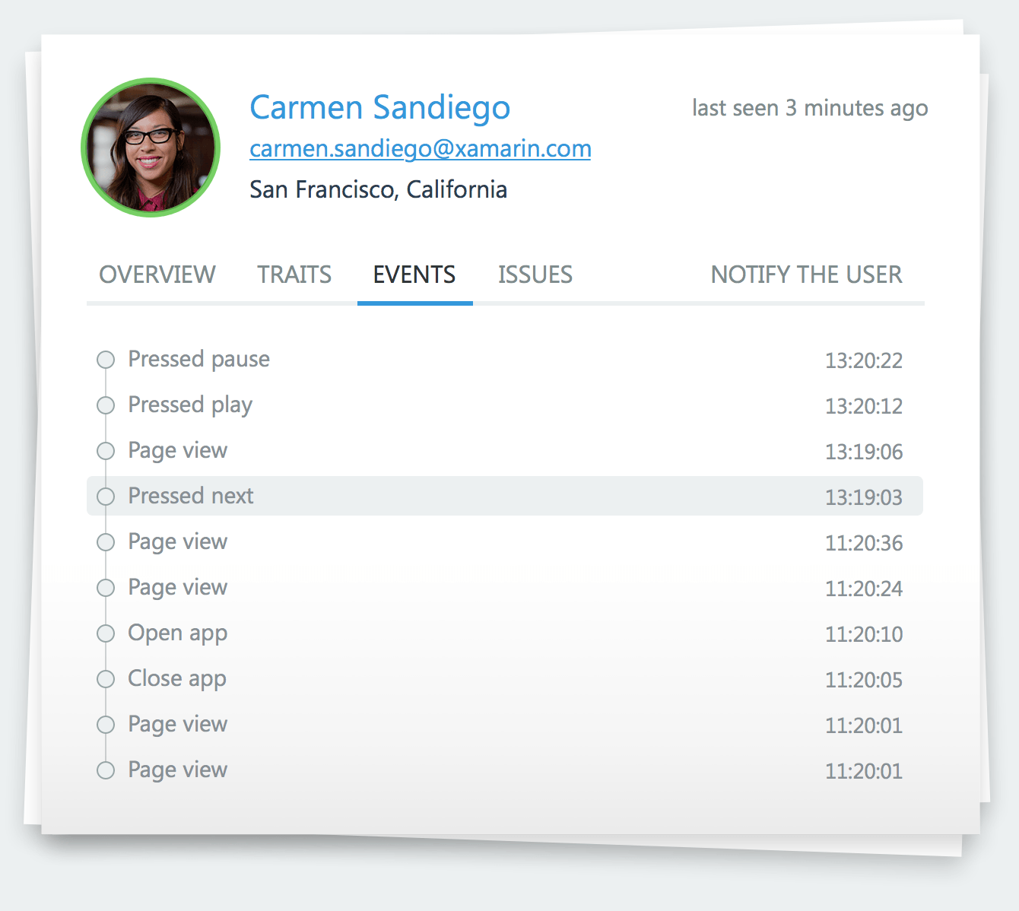
Track
Track any event that occurs in your application.
Even track performance of how long an operation takes.
Notes:
Track to see what is being used the most in your apps, but also use tracking to build up your very own reproduction steps when a crash does occur.

Slide 31
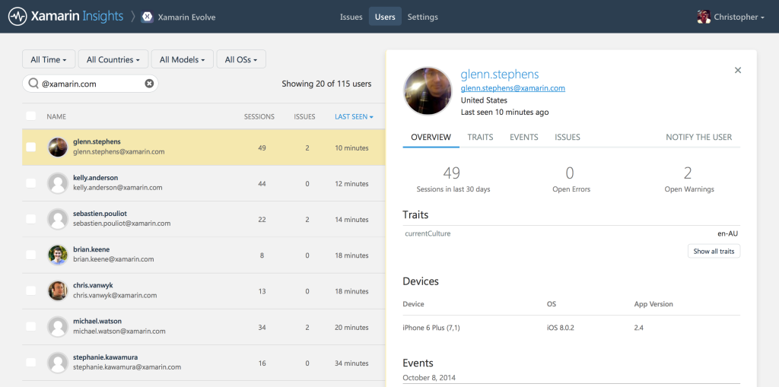
Identify
Combine event tracking with user identification to resolve issues faster.
Notes:
If you are in an enterprise you can actually Identify your users so you can see who’s app crashed, get specifics about the device, and email them immediately when you fix a bug.
When tracking any data like this you should of course tell your users. We all should be responsible developers when it comes to privacy.

Slide 32





Integrate
Simple integrations into popular services for mission critical notifications.
Notes:
Most important of course if getting alerts. Xamarin Insights has full email alerts, but you can also integrate into popular services for mission critical notifications.

Slide 33
Demo
Notes:
Let’s see it in action.

Slide 34








Find bugs before your users do
Start immediately
Dedicated QA engineers get you up and running with Xamarin Test Cloud fast
Beautiful reports
More than detailed technical feedback, stunning visual reporting performance monitoring
Hundreds of devices
Be confident that your apps function correctly and look great on real devices
Test for fragmentation
Test automatically on hundreds of combinations of operation systems, screens and resolutions
Continuous Integration
Integrate Xamarin Test Cloud into your continuous integration process or ALM
Object-based UI testing
Test your entire app, from the UI down, using object-level user interface testing
Notes:
So let’s find and fix bugs before our users do.

Slide 35
Mobile Quality Matters
Mobile != Desktop Development
Iterate quickly, but don’t turn your users into beta testers.
Use Insights to Improve Apps
xamarin.com/insights
xamarin.com/test-cloud

Slide 36

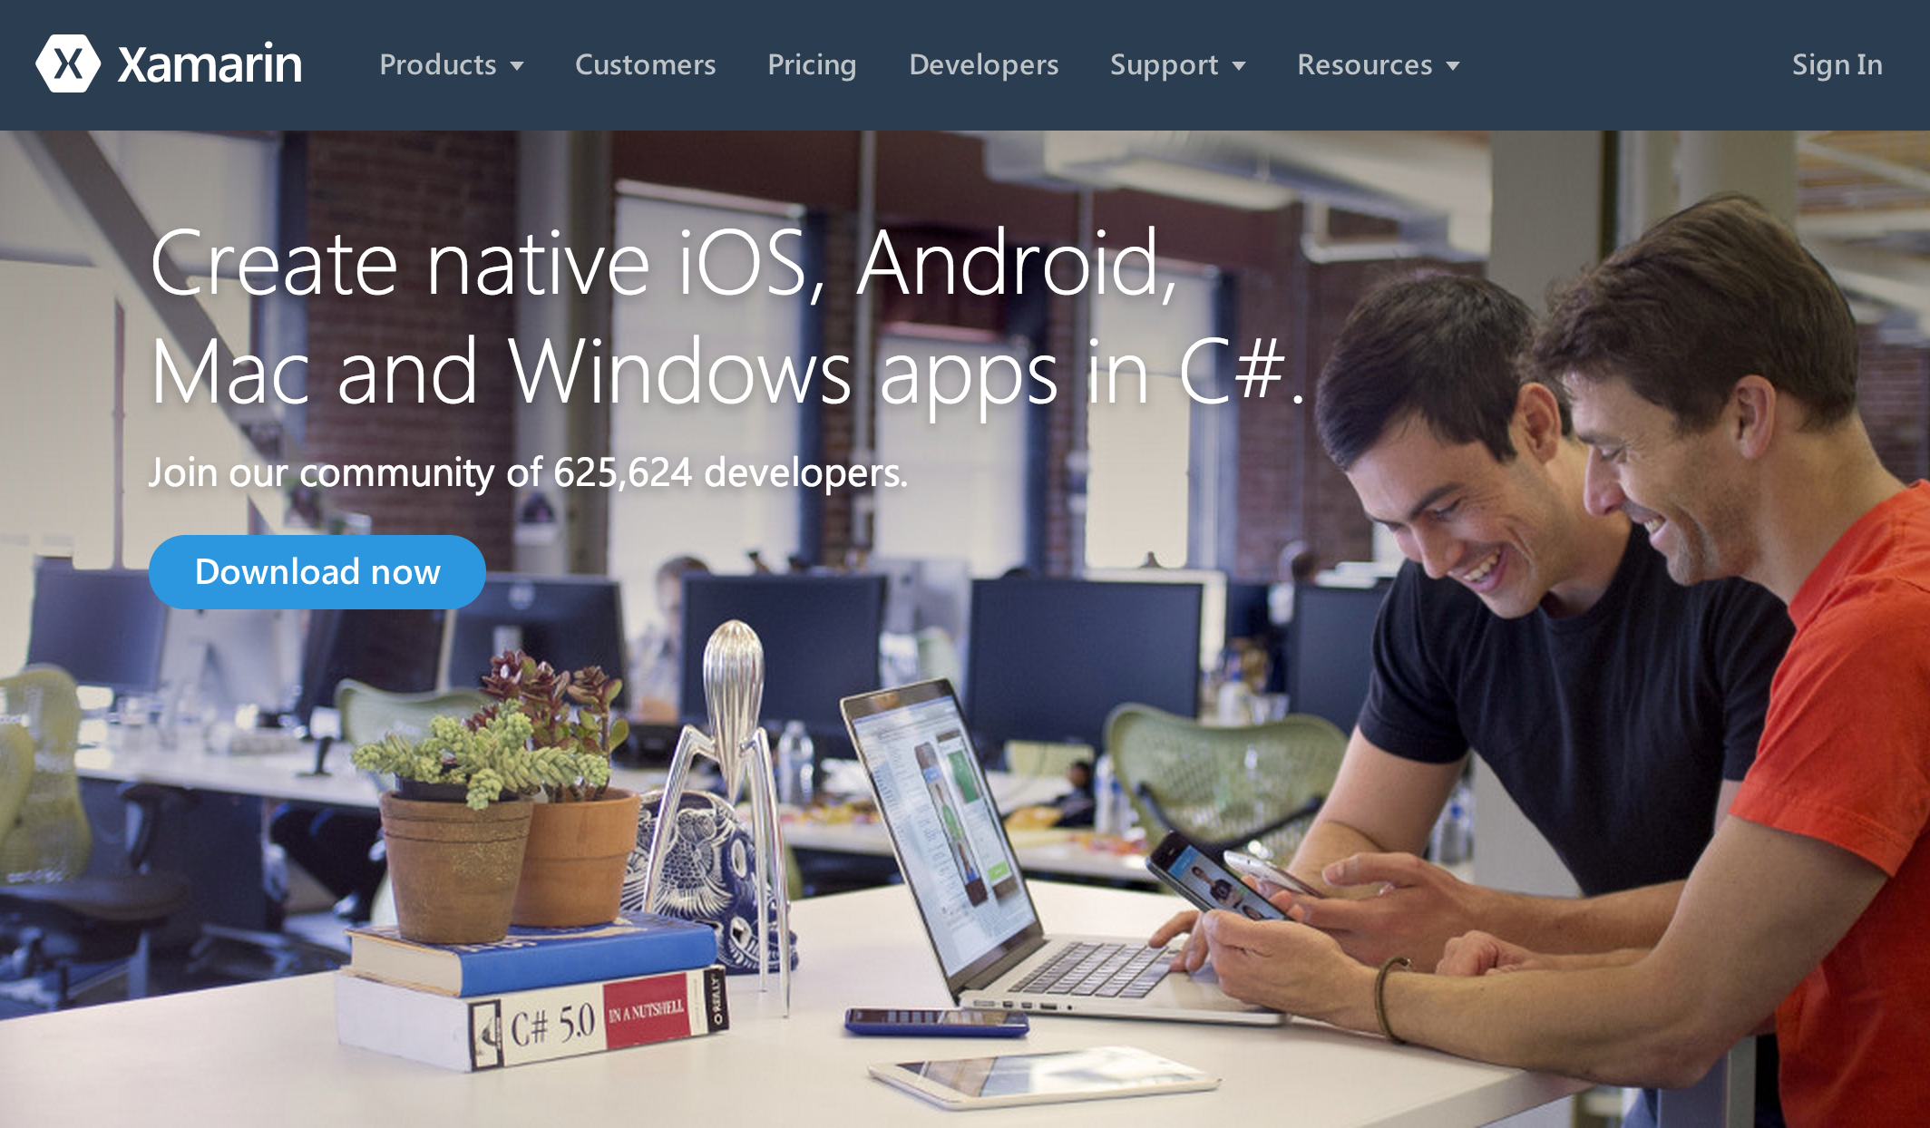
Get Started Today: xamarin.com/download

